Slide 1
AGENTIC AI HEALTH SYMPTOM CHECKER
CAPSTONE PROJECT
Presented By:
Student Name- B. Surya Teja
College Name- Presidency University Bangalore
Department- Computer science Engineering

Slide 2
OUTLINE
Problem Statement
Proposed System/Solution
System Development Approach
Algorithm & Deployment
Result
Conclusion
Future Scope
References

Slide 3
Problem Statement
Access to reliable health guidance is limited, leading many to rely on inaccurate online information for symptom checks. This can cause panic, misinformation, or delayed treatment. The challenge is to build an AI-powered Health Symptom Checker using IBM Cloud Lite and IBM Granite that allows users to input symptoms in natural language. It will analyze symptoms, suggest possible conditions, offer home remedies, recommend when to see a doctor, and support multiple languages—using only verified medical sources. This tool aims to promote early detection and informed health decisions while reducing self-diagnosis risks.

Slide 4
Proposed Solution
The Agentic AI Health Symptom Checker is developed using the IBM watsonx platform, leveraging advanced language models and workflow architectures to provide intelligent, reliable, and educational health guidance to users. Building with IBM watsonx Agent Lab using LangGraph and ReAct architecture, with LLaMA-3-70B-Instruct model.Data
Agent Framework & Architecture:
Used to create composable workflows with branching, which helps structure the symptom-to-response pipeline.
Allows the agent to reason about the user’s symptoms and take actions (e.g., search, recommend, respond).
Model Configuration:
This open-source LLM is responsible for understanding and generating natural language responses based on user symptom inputs.
You’ve left Temperature, Top-P, Presence Penalty as default or zero, indicating you are aiming for more deterministic and factual responses, which is ideal for health-related information..
User Interaction:
The agent receives natural language inputs (e.g., “I have sore throat and fever”).
LLaMA model interprets symptoms and extracts key health indicators using prompt-instructed reasoning.
Medical Information Retrieval (Planned or Integrated):
The agent can be connected to:
Custom Tools: To retrieve from trusted sources (e.g., WHO, CDC, Indian MoHFW).
Knowledge Bases: Using LangGraph, you can set up condition-action chains to answer:
What could be the cause?
When should the user consult a doctor?
Are home remedies safe here?

Slide 5
Proposed Solution
Deployment & Access:
After configuration and testing via the Agent Preview, the solution can be deployed using watsonx’s native deployment tools.
This allows the agent to be integrated with frontend platforms such as mobile apps, websites, or WhatsApp interfaces for broader reach.
Optional Multilingual Support:
The platform can be extended with IBM Watson Language Translator to support regional language inputs and outputs, increasing accessibility for non-English-speaking users.
Future Enhancements:
Integration with real-time symptom databases or telemedicine platforms
Dashboard for tracking usage and common symptom patterns.
Data anonymization and compliance with health data regulations.

Slide 6
System Approach
System Requirements
The Agentic AI Health Symptom Checker is developed using IBM watsonx tools to provide intelligent, educational, and multilingual symptom guidance. It uses large language models to interpret user input and respond with safe, informative health recommendations.
Platform:
IBM watsonx Agent Lab (Cloud-based)
IBM Cloud Lite or Standard Tier
Compute & Deployment:
Model: LLaMA-3-70B-Instruct via watsonx
Framework: LangGraph
Architecture: ReAct (Reasoning + Acting)
Deployment: Built-in watsonx Agent deploy (optionally extensible to IBM Cloud Code Engine)
Optional Services:
IBM Watson Language Translator (for multi-language support)
IBM Cloudant or DB2 (for session data, logs, or knowledge base)

Slide 7
System Approach
Library required to build the model:
Since the solution is being built primarily using IBM watsonx's no-code/low-code agent tools, most libraries are abstracted within the platform. However, if extending or deploying on a custom backend, the following libraries would be required
Purpose | Libraries / Tools
AI/NLP Models | transformers, torch, langchain, sentence-transformers
Data Processing | pandas, json, spacy (optional)
API & Web Integration | Flask, FastAPI, requests, ibm-watson SDK
Health Data Access | WHO APIs, HealthData.gov, Watson Discovery (optional)

Slide 8
Algorithm & Deployment
Algorithm:
User Input
Natural symptom input (e.g., “I have sore throat and fever”)
NLP Parsing (LLaMA-3)
Extracts symptoms and understands intent
Symptom Analysis
Matches with verified medical data
Assesses urgency (mild, moderate, critical)
Response Generation
Suggests probable causes, home remedies, & when to consult a doctor
Multilingual Support (Optional)
IBM Watson Language Translator for regional access
React Decision Logic
Decide: ask more, escalate, or end session

Slide 9
Algorithm & Deployment
Deployment: The agent is deployed directly within IBM watsonx Agent Lab, which supports zero-code cloud deployment. Steps
Agent is built using LangGraph (workflow) and ReAct (architecture)
LLM (LLaMA-3-70B-Instruct) is assigned to handle user prompts
Model parameters (temperature, token limits) are configured
Optional tools (translation, symptom APIs) are added
The agent is tested in the preview window
Click Deploy to publish the agent
Optional: Integrated into external apps (e.g., website, mobile) using API or webhooks

Slide 10
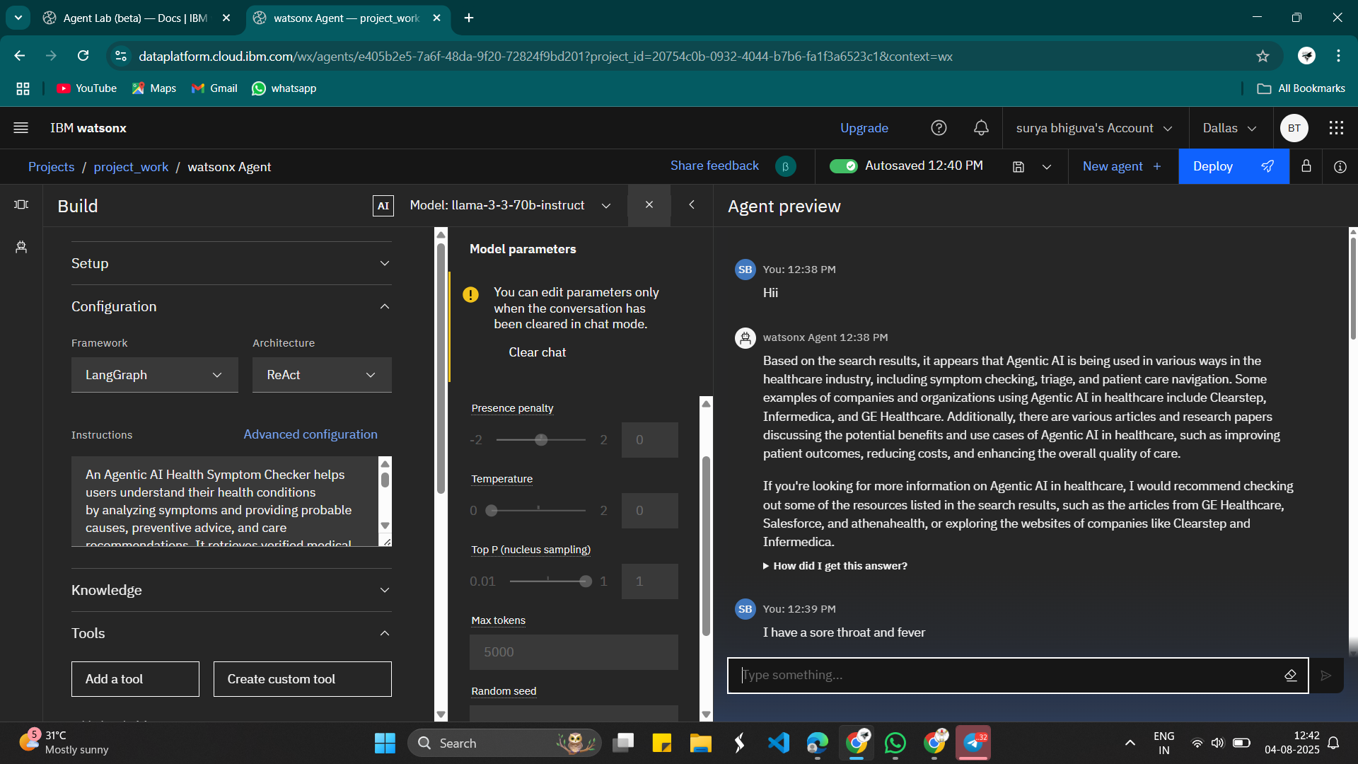
Result

Slide 11
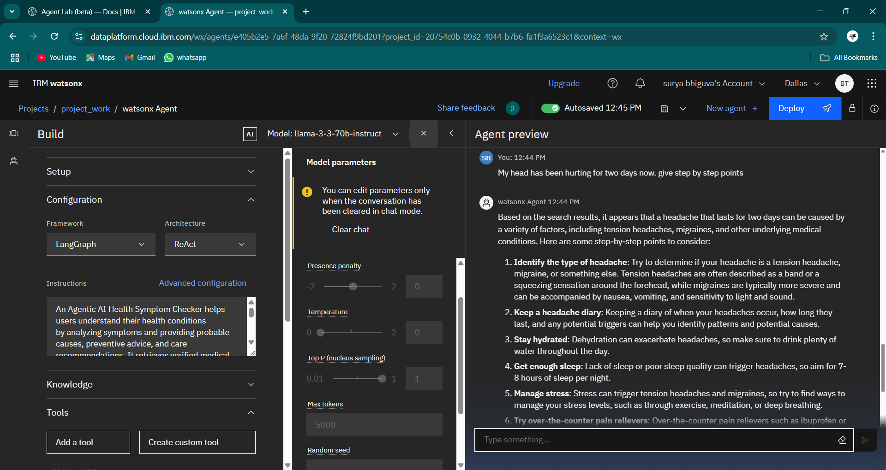
Result

Slide 12
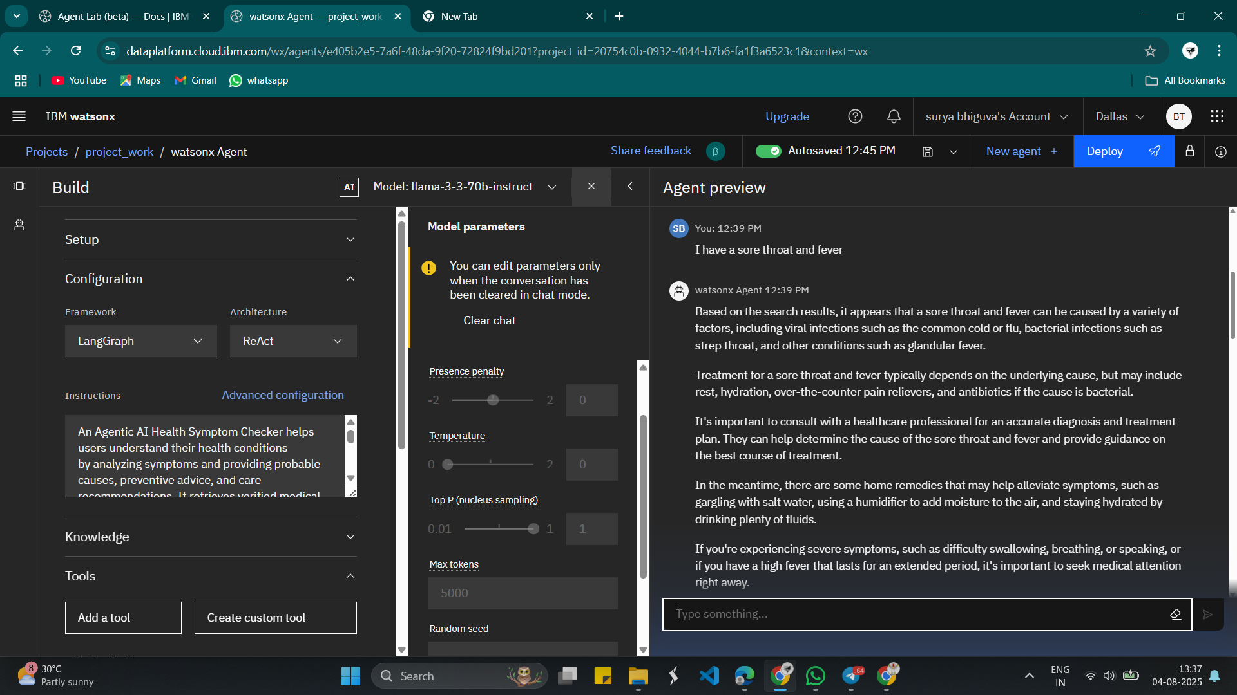
Result

Slide 13
Conclusion
The Agentic AI Health Symptom Checker, developed using IBM Watsonx, demonstrates the effective use of large language models and agentic workflows in the healthcare domain. By combining the LangGraph framework with the ReAct architecture, the system dynamically interprets user inputs and delivers medically relevant responses, helping users better understand their symptoms. It retrieves trusted medical information and offers personalized advice, including probable causes, preventive tips, and care recommendations. This approach not only enhances healthcare accessibility but also reduces the burden on initial clinical consultations. The project highlights how Agentic AI can play a significant role in early diagnosis support and symptom triage, paving the way for intelligent, AI-assisted healthcare solutions.

Slide 14
Future scope
The Agentic AI Health Symptom Checker has promising potential for future development and integration in various areas of digital healthcare. In the future, the system can be enhanced to support multi-language capabilities, allowing it to serve users from diverse linguistic backgrounds. It can also be integrated with wearable devices and electronic health records (EHRs) to provide more personalized and real-time insights based on a user’s medical history and vitals. Advanced machine learning models can be incorporated for better accuracy in diagnosis and recommendation. Additionally, integrating telemedicine services would enable users to instantly connect with healthcare professionals based on the AI’s triage. The platform can also expand its scope to include mental health assessment, chronic disease tracking, and AI-powered prescription suggestions, making it a comprehensive virtual health assistant.

Slide 15
References
IBM Watsonx Documentation – https://www.ibm.com/products/watsonx
IBM Agent Lab (beta) – https://dataplatform.cloud.ibm.com
LangGraph Framework – https://docs.langchain.com/docs/langgraph
ReAct Architecture for LLMs – Yao et al., “ReAct: Synergizing Reasoning and Acting in Language Models”
GE Healthcare AI Use Cases – https://www.gehealthcare.com
Athenahealth Symptom Checker Insights – https://www.athenahealth.com
WHO – Symptom-based Diagnosis and Digital Health Tools – https://www.who.int

Slide 16
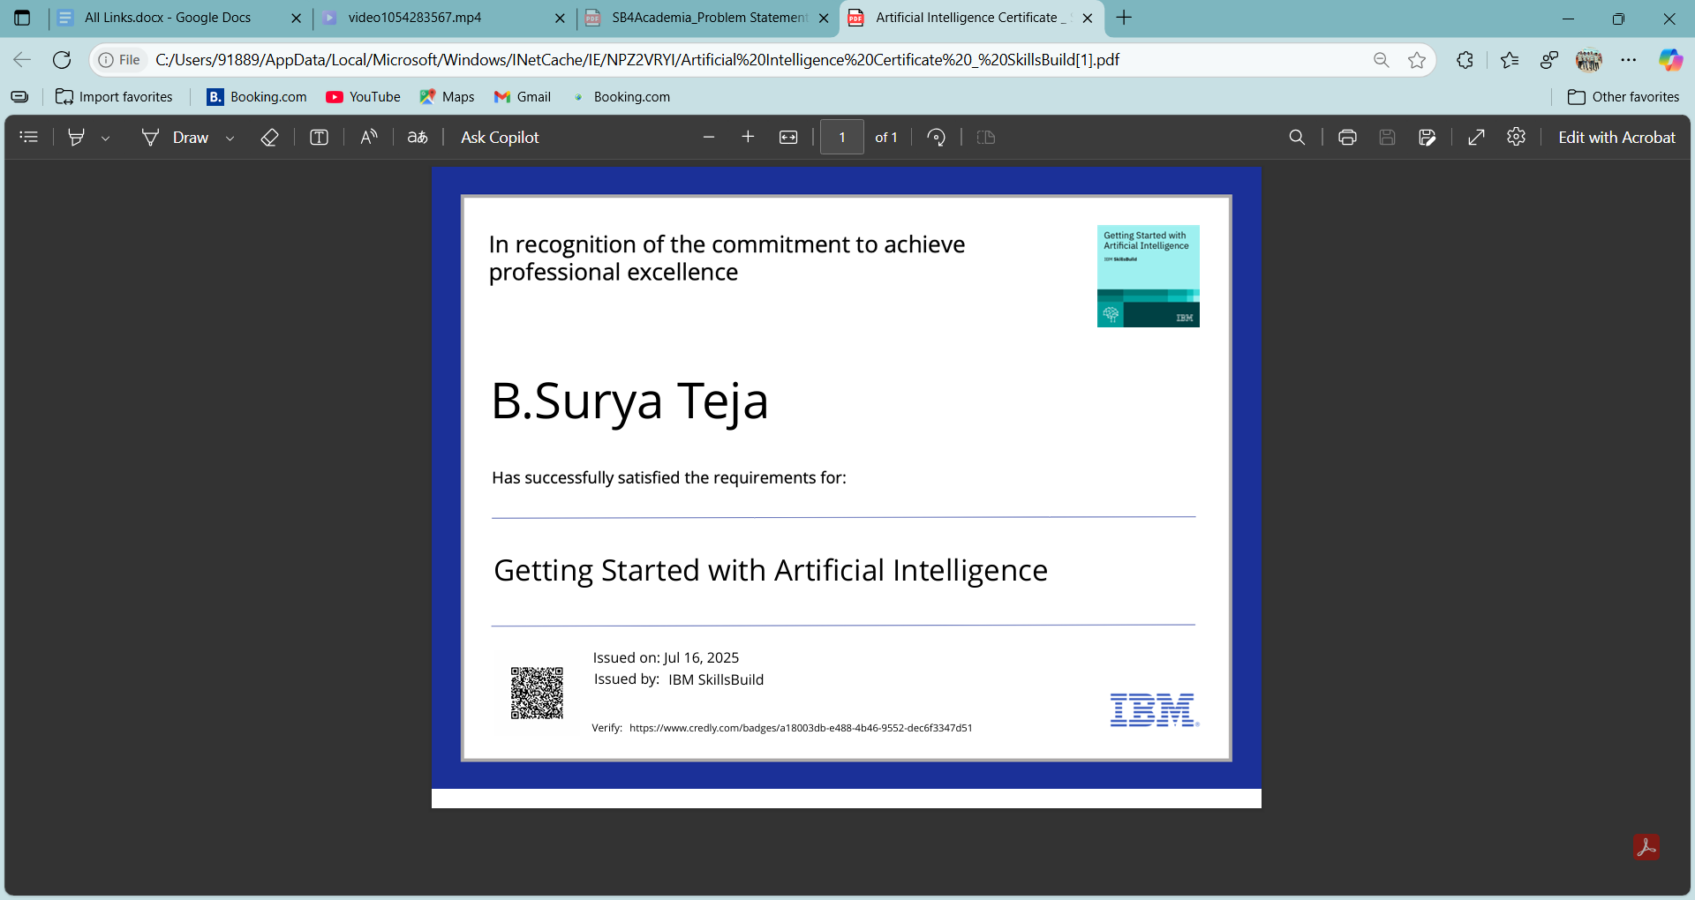
IBM Certifications

Slide 17

IBM Certifications

Slide 18

IBM Certifications

Slide 19
THANK YOU

